Slide 1
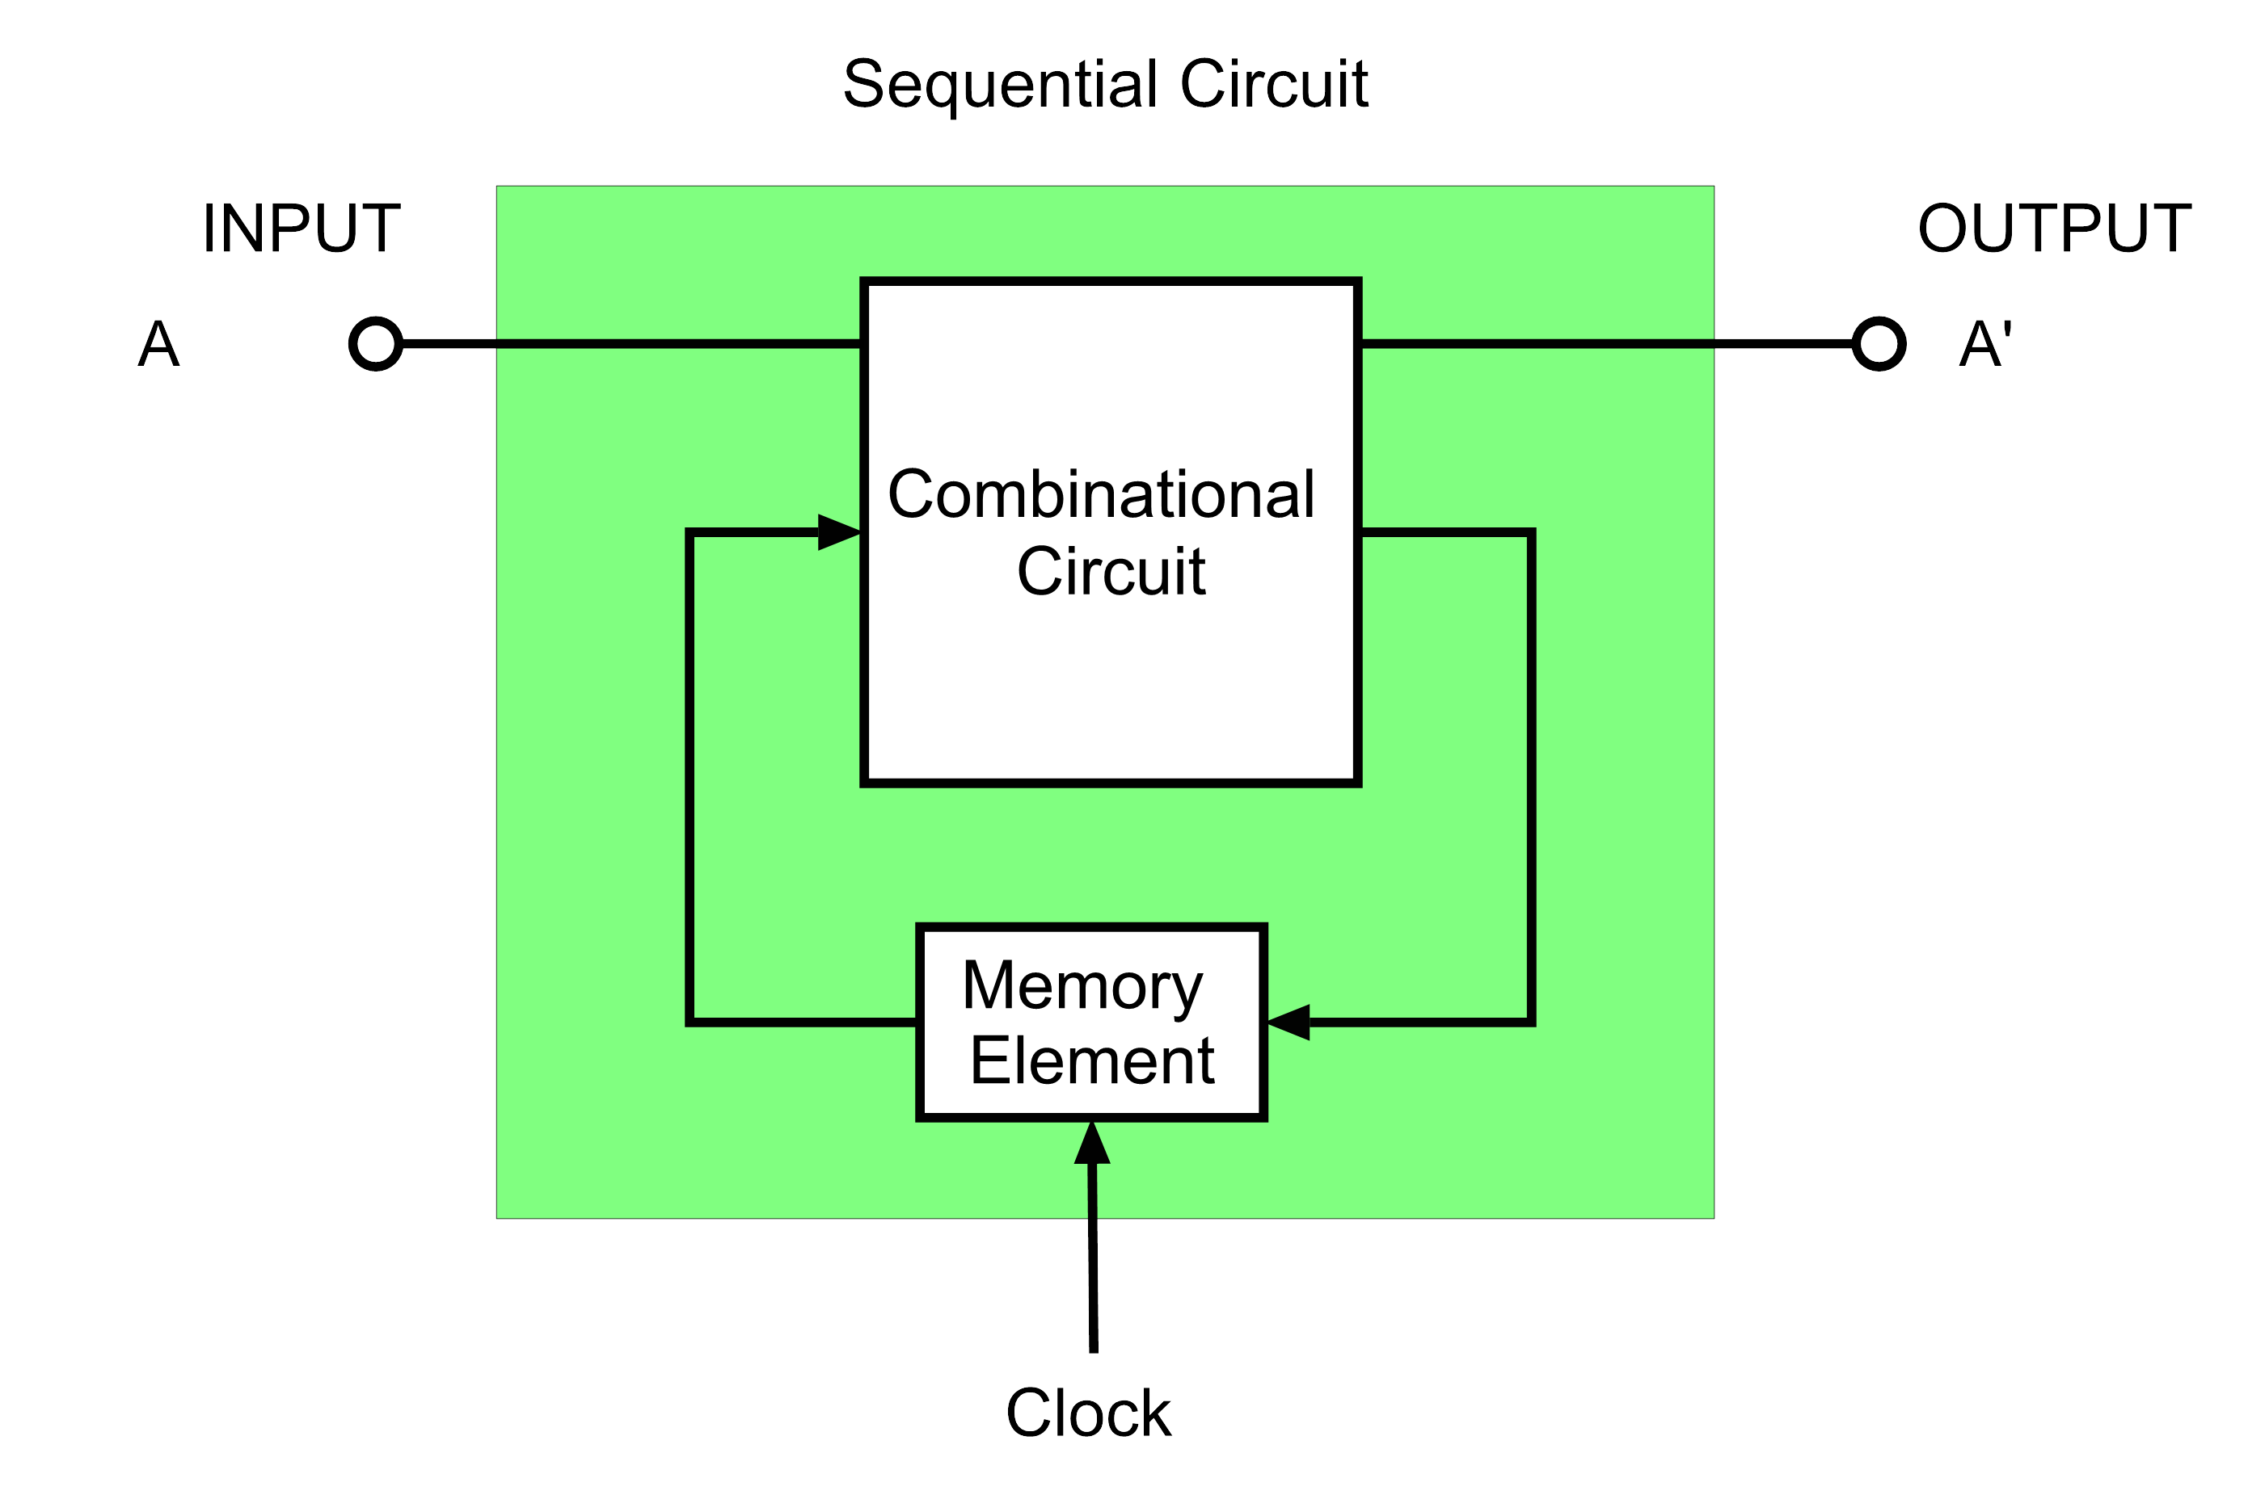
Sequential Circuit
Sequential circuits are digital circuits that store and use previous state information to determine their next state.
They are commonly used in digital systems to implement state machines, timers, counters, and memory elements and are essential components in digital systems design.

Slide 2
Difference between Combinational and Sequential Circuit
Aspect | Combinational Circuit | Sequential Circuit
Definition | Output depends only on the current inputs. | Output depends on both current inputs and past states (memory).
Memory Elements | Does not require memory elements. | Requires memory elements like flip-flops or latches.
Timing Dependency | Output is immediate, based on input changes. | Output is dependent on clock pulses and previous states.
Clock Signal | No clock signal required. | Requires a clock signal to synchronize state changes.
Design Complexity | Simpler design without the need for memory. | More complex due to memory and clock management.
Speed | Faster, as outputs change instantly with inputs. | Slower due to dependency on clock cycles and past states.
Functionality | Performs basic logical operations without sequence dependency. | Performs operations that require sequences or timed events.

Slide 3
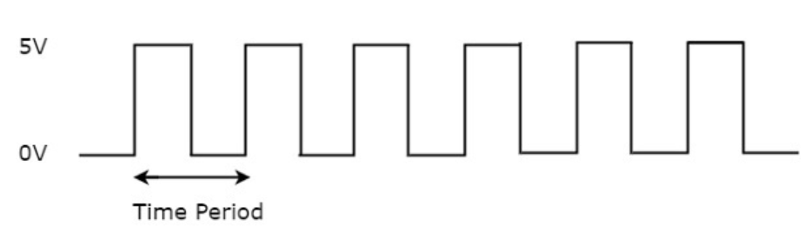
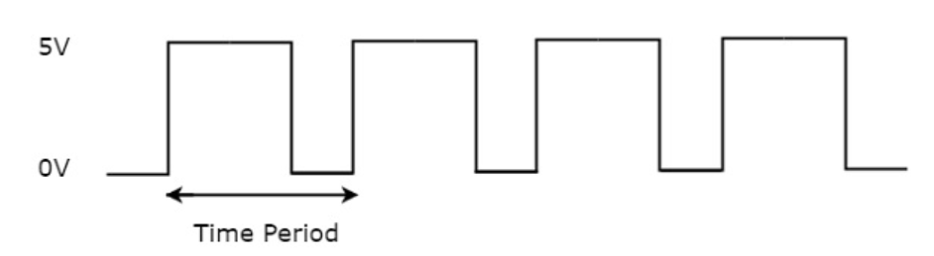
Clock signal
Clock signal is a periodic signal .
We can represent the clock signal as a square/rectangular wave or trains of pulses.
the time period will be equal to sum of ON time and OFF time.

Slide 4
Types of Triggering
Level Triggering
Positive level Triggering
Negative level Triggering
Edge Triggering
Positive Edge Triggering
Negative Edge Triggering

Slide 5
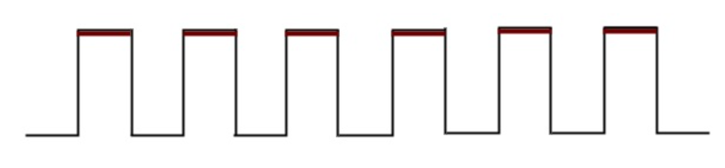
Positive level triggering
If the sequential circuit is operated with the clock signal when it is in Logic High, then that type of triggering is known as Positive level triggering.

Slide 6
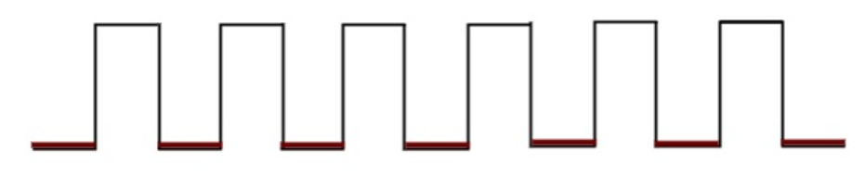
Negative level triggering
If the sequential circuit is operated with the clock signal when it is in Logic Low, then that type of triggering is known as Negative level triggering.

Slide 7
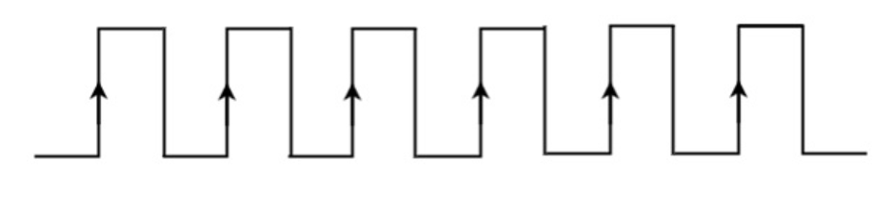
Positive Edge Triggering
If the sequential circuit is operated with the clock signal that is transitioning from Logic Low to Logic High, then that type of triggering is known as Positive Edge Triggering. It is also called as rising edge triggering.

Slide 8
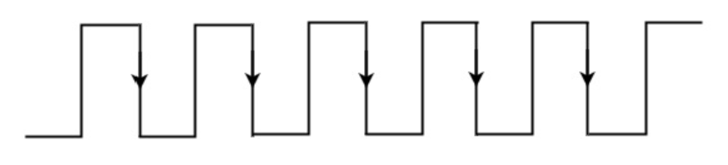
Negative Edge Triggering
If the sequential circuit is operated with the clock signal that is transitioning from Logic High to Logic Low, then that type of triggering is known as Negative Edge Triggering. It is also called as falling edge triggering.

Slide 9
Latches
Latches are digital circuits that store a single bit of information and hold its value until it is updated by new input signals. They are used in digital systems as temporary storage elements to store binary information. Latches can be implemented using various digital logic gates, such as AND, OR, NOT, NAND, and NOR gates.
Latches are widely used in digital systems for various applications, including data storage, control circuits, and flip-flop circuits. They are often used in combination with other digital circuits to implement sequential circuits, such as state machines and memory elements.

Slide 10
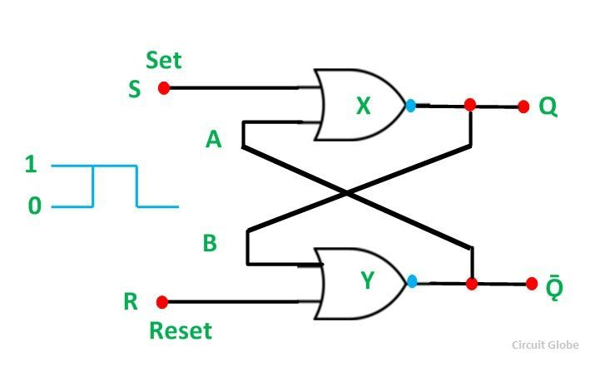
SR Latches using NOR gate

Slide 11
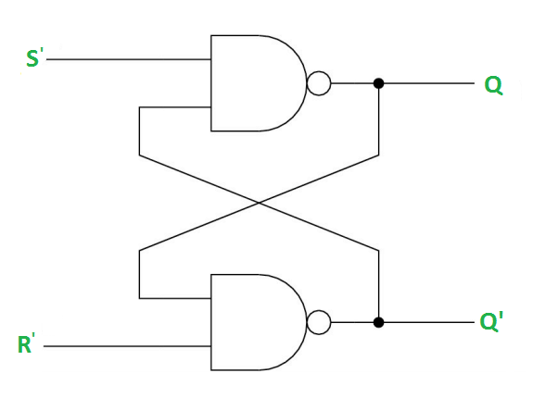
SR Latches using NAND gate

Slide 12
FLIP FLOP
basic digital memory circuit,which stores one bit of information.
It is also known as a bistable multivibrator or a binary or one-bit memory.
The state of flip-flops changes at the active state of clock pulses and remains unaffected when the clock pulse is not active.

Slide 13
Block Diagram of FLIP FLOP
OUTPUT
INPUTS
Flip Flop
CLOCK
OUTPUT

Slide 14
Flip-Flop | Latch
Flip-flop is a bistable device i.e., it has two stable states that are represented as 0 and 1. | Latch is also a bistable device whose states are also represented as 0 and 1.
It checks the inputs but changes the output only at times defined by the clock signal or any other control signal. | It checks the inputs continuously and responds to the changes in inputs immediately.
It is a edge triggered device. | It is a level triggered device.
Gates like NOR, NOT, AND, NAND are building blocks of flip flops. | These are also made up of gates.
They are classified into asynchronous or synchronous flipflops. | There is no such classification in latches
It forms the building blocks of many sequential circuits like counters. | These can be used for the designing of sequential circuits but are not generally preferred.
Flip-flop always have a clock signal | Latches doesn’t have a clock signal
Flip-flop can be build from Latches | Latches can be build from gates
ex:D Flip-flop, JK Flip-flop | ex:SR Latch, D Latch

Slide 15
SR- FLIP FLOP

